Slide 1
Nepaleo: Market Entry Framework
Nepal Economics Olympiad | 2022
Business Case Analysis
Team Irving Fisher

Slide 2
Executive Summary
What How When
Initial production (2023)
International expansion
(after 2026)
Mineral water Himalayan water
(Domestic) (International)
Plant in Dhankuta
Use of PET material
1

Slide 3
Domestic Barriers to Entry
Technical
Start-up cost
Economies of scale
Legal
Standard/Regulations
Licenses/Permits
2

Slide 4
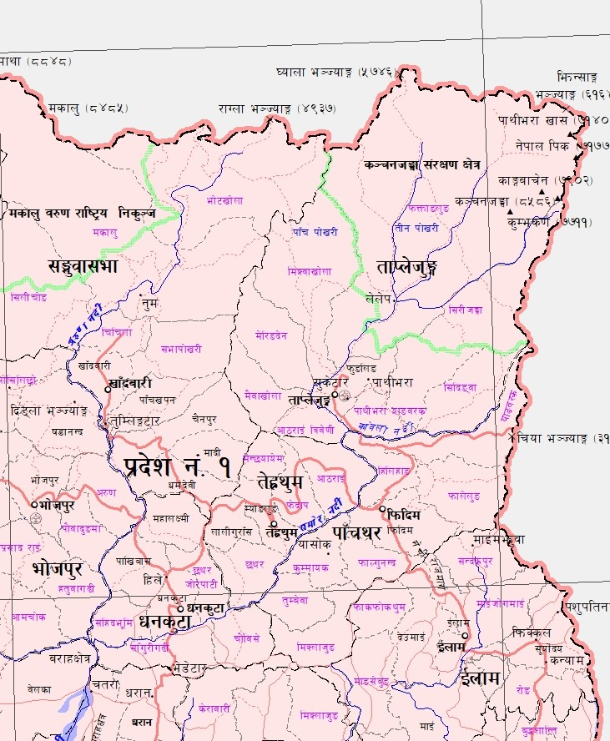
Water Source
Extraction of water
Manufacturing the plant

Slide 5
Domestic Market Size Analysis
54 Million USD market price in 2015
CAGR 8.1%
Expected that the market share will be 12 arab market share in 2023
4

Slide 6
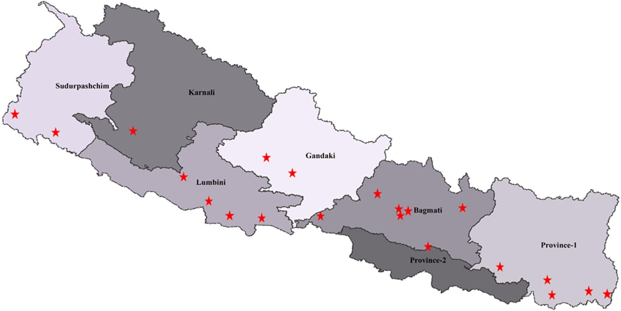
Domestic Market of Mineral Bottled Water
5

Slide 7
Strategic Plan
Creating a Nepali Brand in face of International Brands
R&D Expenditure
Exploiting economies of scale
Cost-effective packaging and bottling
6

Slide 8
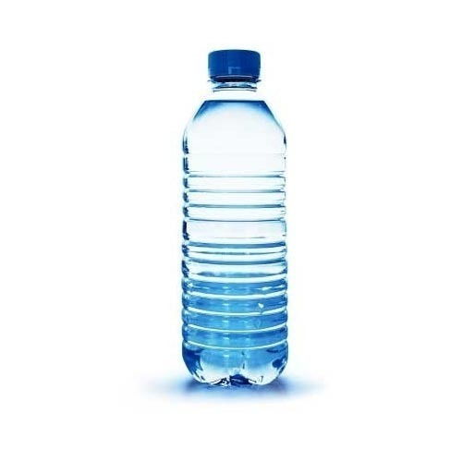
Manufacture, Distribution & Pricing
Semi-Automatic Plant(2000l/hr capacity)
Two product lines
B2B supply chain
Unit price to wholesalers; Rs. 10 -12
PET (polyethylene terephthalate)
Cheapest Material Rs. 5/litre
7

Slide 9
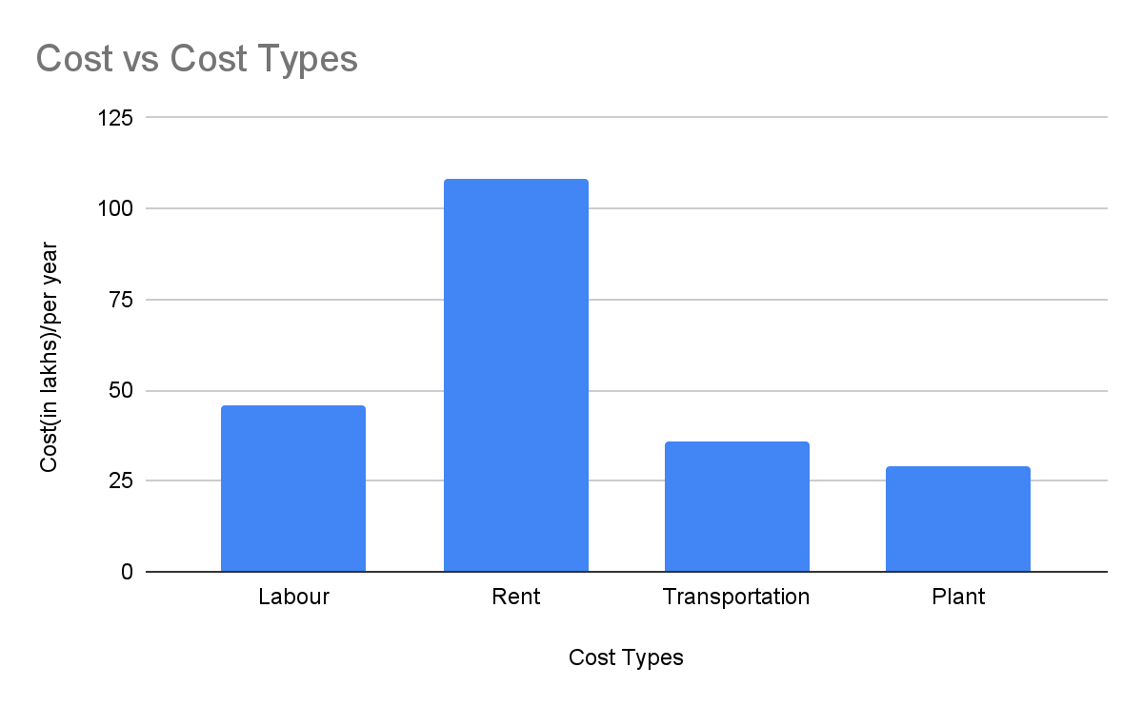
Cost Projection
8

Slide 10
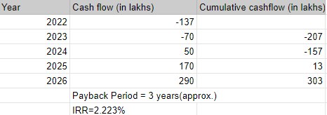
Payback Period
9

Slide 11
International Barriers to Entry
Technical
Start-up cost
Economies of scale
Brand Loyalty
Strategy
Limit pricing
Legal
Standard/Regulations
Licenses/Permits
10

Slide 12
International Feasibility
Ever- increasing demand for healthier lifestyle
Prospect of International Grant (subsidy)
Promoting product as “The Natural Taste of Himalayas”
11

Slide 13
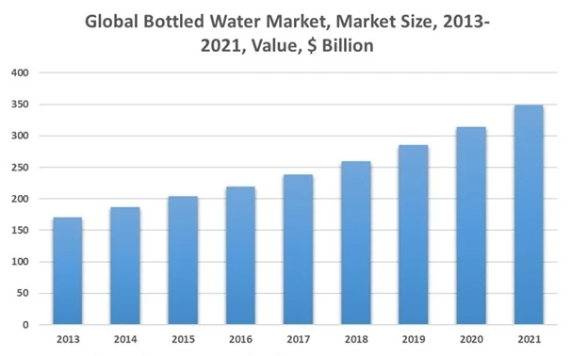
Source: The Business Research Company
12

Slide 14
Projected International Target Market
Europe
Japan
China
HongKong
Singapore
South Korea
Italy
United States of America
Gulf countries
13

Slide 15
International competitors
Indirect Competition Direct Competition
Bisleri International - Himalayan Water (India)
Agro Tech Food - Rasuwa Water (Nepal)
Parle Agro Products Ltd. - Himalayas on Top (Nepal)
Coca Cola Beverages Ltd.
Pepsico International
14

Slide 16
International Pricing & Expansion Strategy
Premium segment target group with a preference for supreme quality of water
Price per unit; 2.5$-3$ per litre
Gaining market share in domestic market & reinvesting in international market
Exploiting the gift of nature to lead as a mineral water producing firm by offering superior taste
15

Slide 17
Timeline
.
2024
2025
2023
2%-3% market share
2026
2022
Supernormal profits in domestic
market
International expansion
Start production;
1% or 2% domestic market share gain
Initial plant setup
16

Slide 18
Conclusion
Nepaleo has to start off with major need of cash for which it can choose source of funding it seems fit
It would take around 3 years for the firm to reach break-even point
After setting a stronghold in its domestic operations, it can further export to international market with the help of government subsidies and other available resources
Irving Consultant Firm
17

Slide 19
References
https://ekantipur.com/news/2022/03/07/16466140775904448.html
https://customs.gov.np/page/fts-fy-207879
https://www.rasuwawater.com/aboutus
https://www.mbaskool.com/brandguide/food-and-beverages/6215-himalayan-mineral-water.html
https://kathmandupost.com/money/2020/08/10/government-sets-maximum-retail-price-of-bottled-water-prices-reduced
https://www.jointread.com/top-bottled-water-companies-in-nepal/
https://www.nepalitimes.com/here-now/nepals-water-in-qatar/
https://bestbusinessideas.in/mineral-water-bottling-plant/

